Slide 1
A Descriptive Analysis on Credit Card Dataset
Data Exploration and Visualization
Predictive Analytics - I
Group Members
Basanta Chalise
Divya Sinha
Santosh Chapagain
Wei Gu
03/13/2019

Slide 2


Dataset Introduction
Data Source
A Credit Card Company from Sioux Falls
Data
Information on several parameters for its customers for year 2010
Total rows: 97,465
9,997 Unique Customers Record
Information on 26 different variables
Variable types:
Dates
Payments/Purchases Amounts
Quality Scores
5963 rows have more than 90% information missing
14 duplicates within the dataset.

Slide 3
What’s the Question?
Which customers bring profit to the company and which do not?
Any visible pattern for prediction in the dataset?
Any significantly important variables in predicting the beneficial and non-beneficial customers?

Slide 4
Data Pre-Processing and some findings
✓
✓
✓
✓
✗
✗
✓
✓
✓
✓
✗
✗
Account opened as early as 1996-10-04 and as late as 2010-02-10
Number of months the card was open
Min | 2
Max | 171
Mean | 91.72
Median | 95
Delinquency Days
Min | 2
Max | 270
Mean | 17.77
Median | 0
Credit Limit
Min | 0
Max | 2500
Mean | 326.8
Median | 300
FICO score
Min | 0
Max | 811
Mean | 566.2
Median | 581
Behavior Score
Min | 13
Max | 724
Mean | 612.4
Median | 648
Good Customer Score
Min | 0
Max | 1000
Mean | 749.7
Median | 727

Slide 5
Anomalies in the Dataset
The earliest payment date for the variable ‘Last Payment Date’ backs up to 1900-01-01. There are 571 such observations. For the last payment date of 1980-01-01, there are 208 observations. Other last payment dates start from the year 2009.
Some of the observations for the customers do not have ‘Row Num’ = 1. It starts with ‘Row Num’ = 2.
The Good Customer scores are missing for 7681 observations even after preprocessing the data as described before.

Slide 6
Account Status

Slide 7
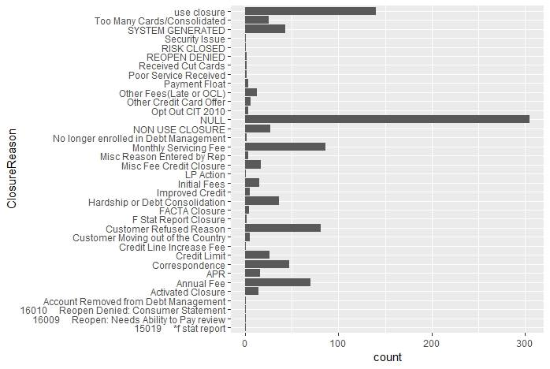
Account Closure Reasons and Their Weights

Slide 8
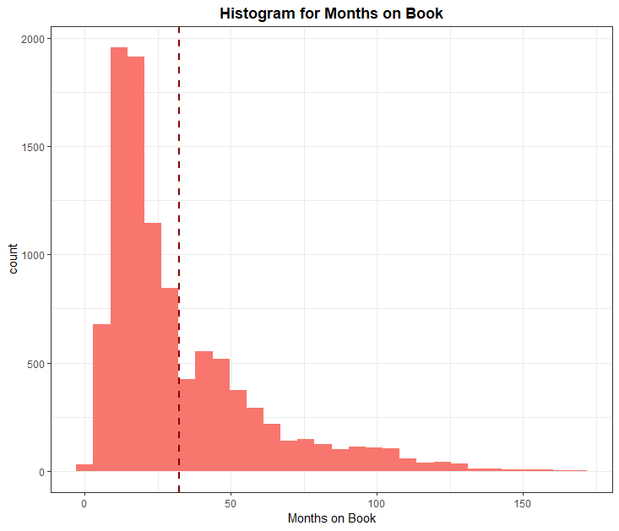
Distribution of Number of Months Credit Card was Open
Skewed Right
Customers using card for more than 130 months is very low
Average number of month the credit card remained open is around 30

Slide 9
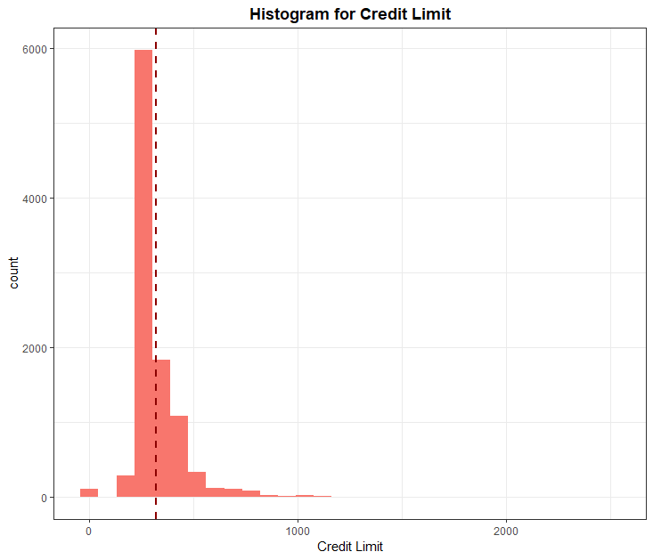
Distribution of Credit Limit of the customers
Credit Limit distribution irrespective of external status of the account
Has normal distribution with mean credit limit of around $200

Slide 10
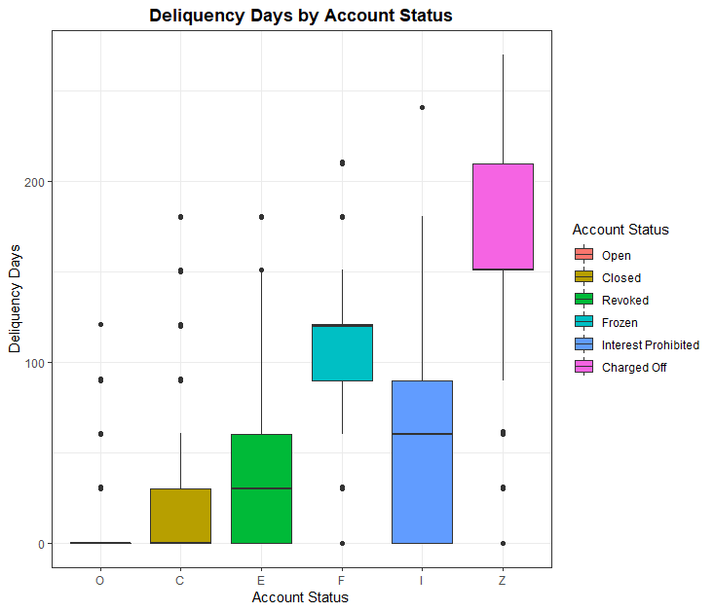
Delinquency Days by External Status
For the open accounts, the mean delinquency days is almost 0
For the charged off accounts, the mean delinquency days is more than 150
The frozen, interest prohibited and revoked accounts also have higher delinquency days

Slide 11
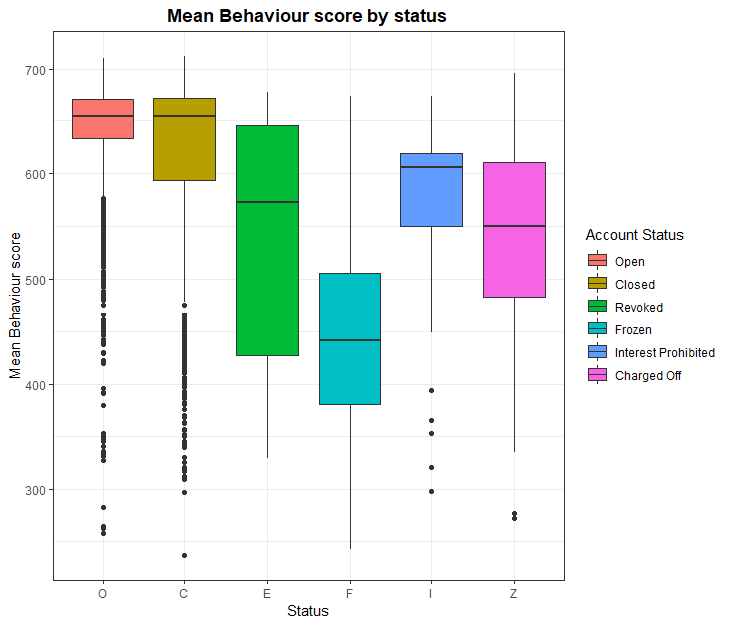
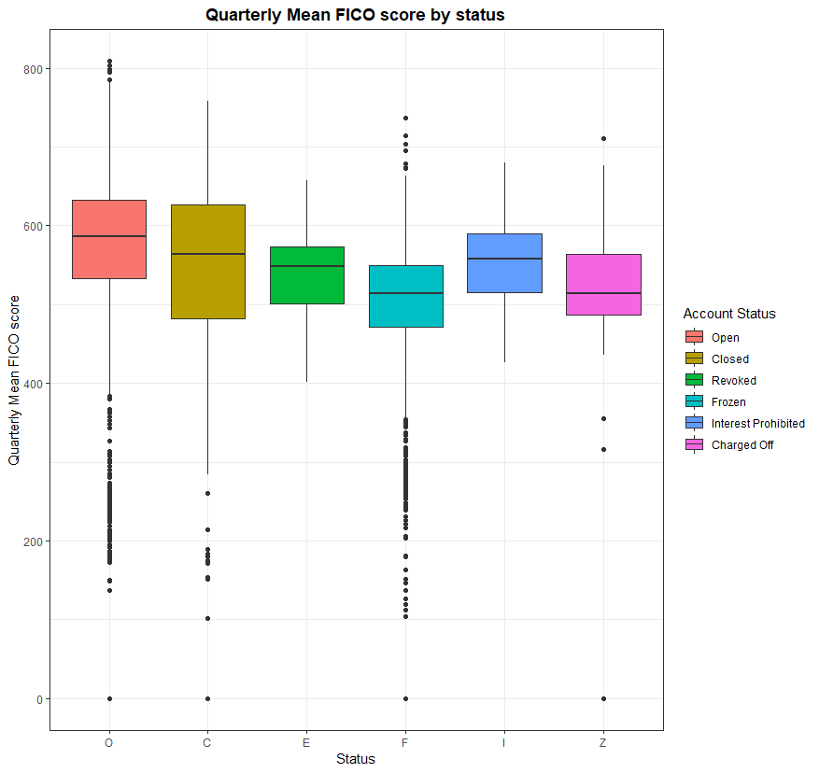
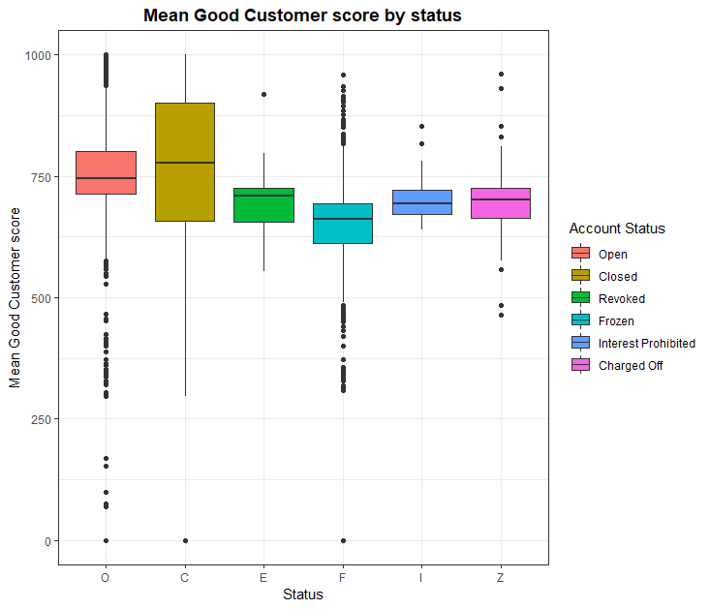
Quality Scores According to the Account Status
First, the mean value of the respective scores for each unique customer was calculated
Then the scores were plotted according to the account status

Slide 12
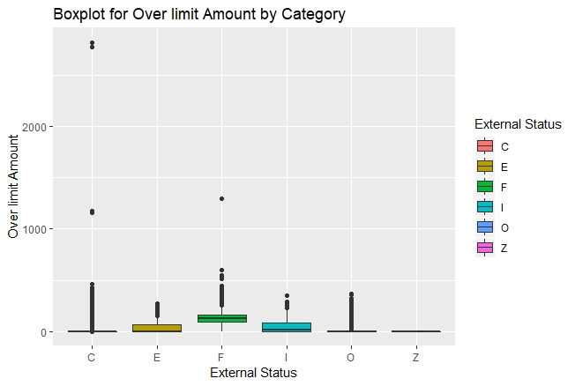
OverLimit Amount versus the Account Category
Numerous observations beyond IQR for all status except the charged off accounts
Mean over limit amount for Frozen status is high followed by the revoked accounts and the accounts whose interest is prohibited.

Slide 13
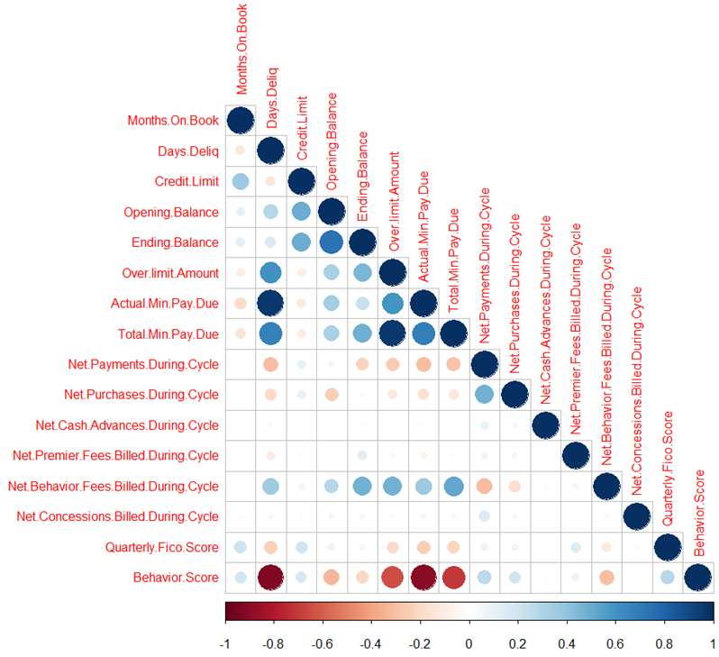
Correlation Between the Numerical Variables in the Dataset
Delinquency Days ↑
Behaviour Score ↓
Actual minimum payment due ↑
Behaviour Score ↓
Total Minimum Payment Due ↑
Over Limit Amount ↑
Actual minimum payment due ↑
Delinquency Days ↑
Over Limit Amount ↑
Behaviour Score ↓
Total minimum payment due ↑
Behaviour Score ↓

Slide 14
Conclusion
Descriptive and Exploratory analysis was performed on the dataset
Most of the accounts were in ‘Open’ status with a few of them ‘Closed’
Variables like ‘Credit Limit’, ‘Months on Book’, ‘Delinquency Days’, ‘Net Payments’, ‘Quarterly FICO Score’, ‘Behavior Score’ and ‘Over limit Amount’ exhibit some sort of relation with the account status.
These variables can be considered more significant for discerning the account status or for predicting the good and bad customer.
The highly correlated variables can be dropped to avoid multicollinearity if this analysis is followed by model development.

